Slide 1

INSTITUTE - UIE
DEPARTMENT- ACADEMIC UNIT-2
Bachelor of Engineering (Computer Science & Engineering)
Subject Name: Introduction to Problem Solving
Code:22CSH-101
Structure: Basics
DISCOVER . LEARN . EMPOWER

Slide 2


Introduction to Problem Solving
Course Objectives
The course aims to provide exposure to problem-solving through programming.
The course aims to raise the programming skills of students via logic building capability.
With knowledge of C programming language, students would be able to model real world problems.

Slide 3



Course Outcomes
CO Number | Course Outcome
CO1 | Remember the concepts related to fundamentals of C language, draw flowcharts and write algorithm/pseudocode.
CO2 | Understand the way of execution and debug programs in C language.
CO3 | Apply various constructs, loops, functions to solve mathematical and scientific problem.
CO4 | Analyze the dynamic behavior of memory by the use of pointers.
CO5 | Design and develop modular programs for real world problems using control structure and selection structure.

Slide 4

Scheme of Evaluation

Slide 5
Introduction
Structure is a user-defined datatype in C language which allows us to combine data of different types together.
Structure helps to construct a complex data type which is more meaningful.
It is somewhat similar to an Array, but an array holds data of similar type only. But structure on the other hand, can store data of any type, which is practical more useful.
For example: If I have to write a program to store Student information, which will have Student's name, age, branch, permanent address, father's name etc, which included string values, integer values etc, how can I use arrays for this problem, I will require something which can hold data of different types together. In structure, data is stored in form of records.

Slide 6
Defining a Structure
struct keyword is used to define a structure. struct defines a new data type which is a collection of primary and derived datatypes.
Syntax:
struct [structure_tag]
{
//member variable 1
//member variable 2
...
}[structure_variables];
Note: The closing curly brace in the structure type declaration must be followed by a semicolon(;).

Slide 7
Example:
struct Student
{
char name[25];
int age;
char branch[10];
// F for female and M for male
char gender;
};
Here struct Student declares a structure to hold the details of a student which consists of 4 data fields, namely name, age, branch and gender. These fields are called structure elements or members.
Each member can have different datatype, like in this case, name is an array of char type and age is of int type etc. Student is the name of the structure and is called as the structure tag.

Slide 8
Declaring Structure Variables
It is possible to declare variables of a structure, either along with structure definition or after the structure is defined.
Structure variable declaration is similar to the declaration of any normal variable of any other datatype.
Structure variables can be declared in following two ways:
Declaring Structure variables separately
Declaring Structure variables with structure definition

Slide 9
Declaring Structure variables separately
struct Student
{
char name[25];
int age;
char branch[10];
//F for female and M for male
char gender;
};
struct Student S1, S2; //declaring variables of struct Student

Slide 10
Declaring Structure variables with structure definition
struct Student
{
char name[25];
int age;
char branch[10];
//F for female and M for male
char gender;
}S1, S2;
Here S1 and S2 are variables of structure Student.

Slide 11
Initializing structure members
Structure members cannot be initialized with declaration. For example the following C program fails in compilation.
struct Point
{
int x = 0; // COMPILER ERROR: cannot initialize members here
int y = 0; // COMPILER ERROR: cannot initialize members here
};
The reason for above error is simple, when a datatype is declared, no memory is allocated for it. Memory is allocated only when variables are created.

Slide 12
Structure members can be initialized using curly braces ‘{}’. For example, following is a valid initialization.
struct Point
{
int x, y;
};
int main()
{
// A valid initialization. member x gets value 0 and y
// gets value 1. The order of declaration is followed.
struct Point p1 = {0, 1};
}

Slide 13
Computing Size of Structure without sizeof()
We can calculate the size of structure using pointers. Below is the implementation.
#include<stdio.h>
struct MySize
{
int a;
int b;
};
int main()
{
struct MySize *Msz=0;
int size = ((char*)(Msz+1))-((char *)(Msz));
printf("\n Structure Size :[%d]", size);
return 0;
}
Output:
Structure Size :[8]

Slide 14
Structure Padding
The sizeof for a struct is not always equal to the sum of sizeof of each individual member.
This is because of the padding added by the compiler to avoid alignment issues.
Padding is only added when a structure member is followed by a member with a larger size or at the end of the structure.
Different compilers might have different alignment constraints as C standards state that alignment of structure totally depends on the implementation.

Slide 15
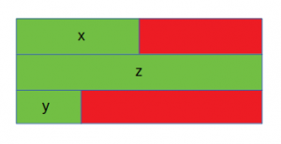
Let’s take a look at the following examples for better understanding:
Case 1:
// C program to illustrate
// size of struct
#include <stdio.h>
int main()
{
struct A {
// sizeof(int) = 4
int x;
// Padding of 4 bytes
// sizeof(double) = 8
double z;
// sizeof(short int) = 2
short int y;
// Padding of 6 bytes
};
printf("Size of struct: %ld", sizeof(struct A));
return 0;
}
Output:
Size of struct: 24
The red portion represents the padding added for data alignment and the green portion represents the struct members. In this case, x (int) is followed by z (double), which is larger in size as compared to x. Hence padding is added after x. Also, padding is needed at the end for data alignment.

Slide 16
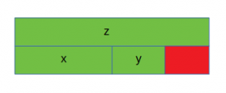
Case 2:
// C program to illustrate
// size of struct
#include <stdio.h>
int main()
{
struct B {
// sizeof(double) = 8
double z;
// sizeof(int) = 4
int x;
// sizeof(short int) = 2
short int y;
// Padding of 2 bytes
};
printf("Size of struct: %ld", sizeof(struct B));
return 0;
}
Output:
Size of struct: 16
In this case, the members of the structure are sorted in decreasing order of their sizes. Hence padding is required only at the end.

Slide 17
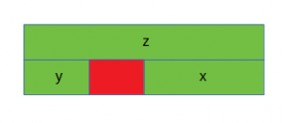
Case 3:
// C program to illustrate
// size of struct
#include <stdio.h>
int main()
{
struct C {
// sizeof(double) = 8
double z;
// sizeof(short int) = 2
short int y;
// Padding of 2 bytes
// sizeof(int) = 4
int x;
};
printf("Size of struct: %ld", sizeof(struct C));
return 0;
}
Output:
Size of struct: 16
In this case, y (short int) is followed by x (int) and hence padding is required after y. No padding is needed at the end in this case for data alignment.
C language doesn’t allow the compilers to reorder the struct members to reduce the amount of padding. In order to minimize the amount of padding, the struct members must be sorted in a descending order (similar to the case 2).

Slide 18
Accessing Structure Members
Structure members can be accessed and assigned values in a number of ways.
Structure members have no meaning individually without the structure.
There are two types of operators used for accessing members of a structure.
. Member operator
-> -Structure pointer operator

Slide 19
Accessing Structure Members by Dot Operator
Example:
#include<stdio.h>
struct Point
{
int x, y;
};
int main()
{
struct Point p1 = {0, 1};
// Accessing members of point p1
p1.x = 20;
printf ("x = %d, y = %d", p1.x, p1.y);
return 0;
}
Output:
x = 20, y = 1

Slide 20
Accessing Structure Members by Structure pointer operator
Example:
#include<stdio.h>
struct Point
{
int x, y;
};
int main()
{
struct Point p1 = {1, 2};
// p2 is a pointer to structure p1
struct Point *p2 = &p1;
// Accessing structure members using structure pointer
printf("%d %d", p2->x, p2->y);
return 0;
}
Output:
1 2

Slide 21
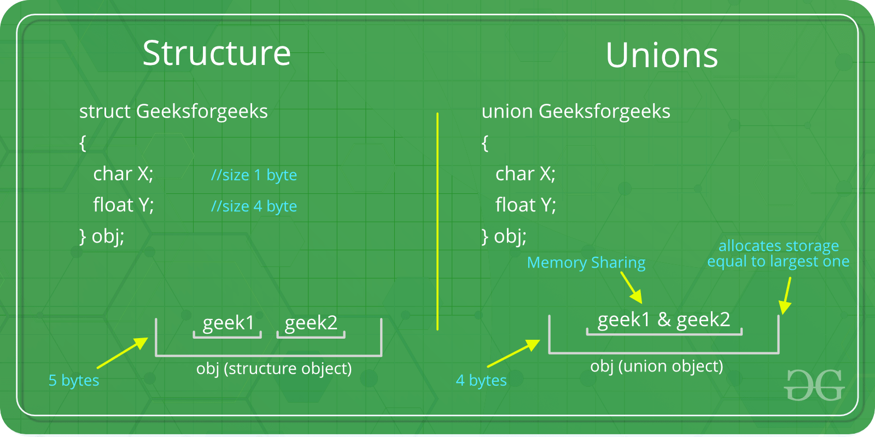
Union
Like Structures, union is a user defined data type.
In union, all members share the same memory location.

Slide 22
For example, In the following C program, both x and y share the same location. If we change x, we can see the changes being reflected in y.
#include <stdio.h>
// Declaration of union is same as structures
union test {
int x, y;
};
int main()
{
// A union variable t
union test t;
t.x = 2; // t.y also gets value 2
printf("After making x = 2:\n x = %d, y = %d\n\n",
t.x, t.y);
t.y = 10; // t.x is also updated to 10
printf("After making y = 10:\n x = %d, y = %d\n\n",
t.x, t.y);
return 0;
}

Slide 23
Output:
After making x = 2:
x = 2, y = 2
After making y = 10:
x = 10, y = 10
To access any member of a union, we use the member access operator (.).
The member access operator is coded as a period between the union variable name and the union member that we wish to access.

Slide 24
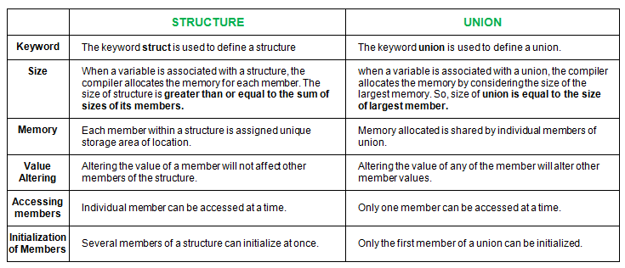
Structure Vs Union

Slide 25
Uses of C Structure
C Structures can be used to store huge data. Structures act as a database.
C Structures can be used to send data to the printer.
C Structures can interact with keyboard and mouse to store the data.
C Structures can be used in drawing and floppy formatting.
C Structures can be used to clear output screen contents.
C Structures can be used to check computer’s memory size etc.

Slide 26
Summary
A structure creates a data type that can be used to group items of possibly different types into a single type.
A structure is a user defined data type in C/C++In dynamic memory allocation, memory is allocated at a run time.
‘struct’ keyword is used to create a structure.
Structure members are accessed using dot (.) operator and -> operator.
Structure members cannot be initialized with declaration.
A structure variable can either be declared with structure declaration or as a separate declaration like basic types.that allocates multiple memory blocks at a time initialized to 0
Size of a union is taken according the size of largest member in union.
A union is a special data type available in C that allows to store different data types in the same memory location.

Slide 27
Frequently Asked question
Q1 What will be the output of the C program?
#include<stdio.h>
int main()
{
struct leader
{
char *lead;
int born;
};
struct leader l1 = {"AbdulKalam", 1931};
struct leader l2 = l1;
printf("%s %d", l2.lead, l1.born);
Ans: AbdulKalam 1931

Slide 28
Q2. What will be the output of the C program?
void main()
{
struct bitfields {
int bits_1: 2;
int bits_2: 9;
int bits_3: 6;
int bits_4: 1;
}bit;
printf("%d", sizeof(bit));
}
Ans: 3
Q3. What are the similarities between structure and union?
Ans: Both are user-defined data types used to store data of different types as a single unit. Their members can be objects of any type, including other structures and unions or arrays. A member can also consist of a bit field. Both structures and unions support only assignment = and sizeof operators. The two structures or unions in the assignment must have the same members and member types.
A structure or a union can be passed by value to functions and returned by value by functions. The argument must have the same type as the function parameter. A structure or union is passed by value just like a scalar variable as a corresponding parameter.
‘.’ operator is used for accessing members.

Slide 29
Q4. Write a program to Store Information in Structure and Display it?
#include <stdio.h> struct student { char firstName[50]; int roll; float marks; } s[10]; int main() { int i; printf("Enter information of students:\n"); // storing information for (i = 0; i < 5; ++i) { s[i].roll = i + 1; printf("\nFor roll number%d,\n", s[i].roll); printf("Enter first name: "); | scanf("%s", s[i].firstName); printf("Enter marks: "); scanf("%f", &s[i].marks); } printf("Displaying Information:\n\n"); // displaying information for (i = 0; i < 5; ++i) { printf("\nRoll number: %d\n", i + 1); printf("First name: "); puts(s[i].firstName); printf("Marks: %.1f", s[i].marks); printf("\n"); } return 0; }

Slide 30
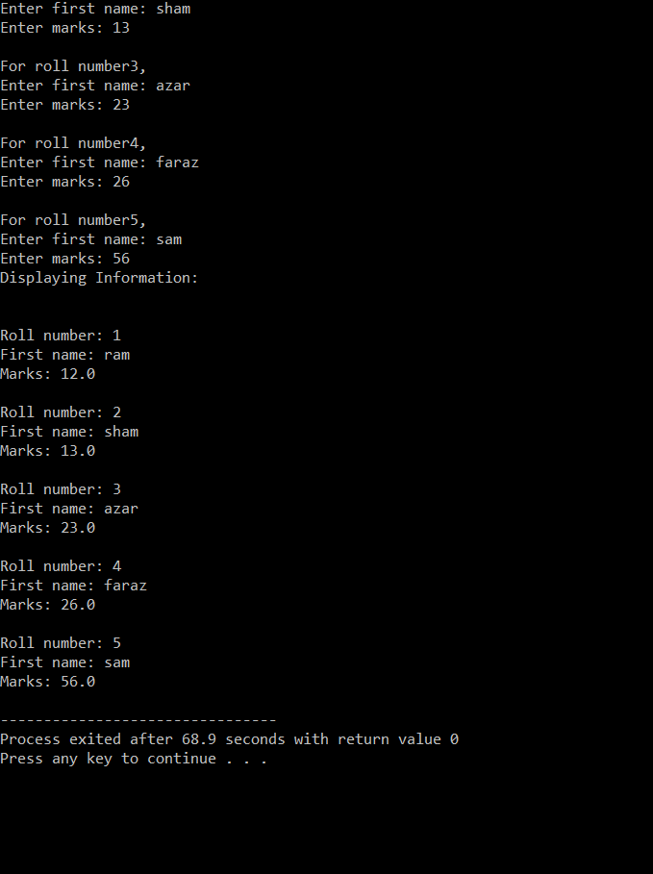
Output:

Slide 31
Assessment Questions:
1. What is the output?
#include <stdio.h>
int main()
{
struct xyz{
int a;
};
struct xyz obj1={1};
struct xyz obj2 = obj1;
printf("%d", obj2.a);
obj2.a = 100;
printf("%d", obj1.a);
return 0;
}

Slide 32
2. What will be the output of the C program?
#include<stdio.h>
int main()
{
struct simp
{
int i = 6;
char city[] = "chennai";
};
struct simp s1;
printf("%d",s1.city);
printf("%d", s1.i);
return 0;
3. Which of the following is a properly defined struct?
A. struct {int a;}
B. struct a_struct {int a;}
C. struct a_struct int a;
D. struct a_struct {int a;};

Slide 33
4. What will be the output of the program?
#include <stdio.h>
struct cppbuzz{
};
int main()
{
printf("%d",sizeof(struct cppbuzz));
return 0;
}

Slide 34
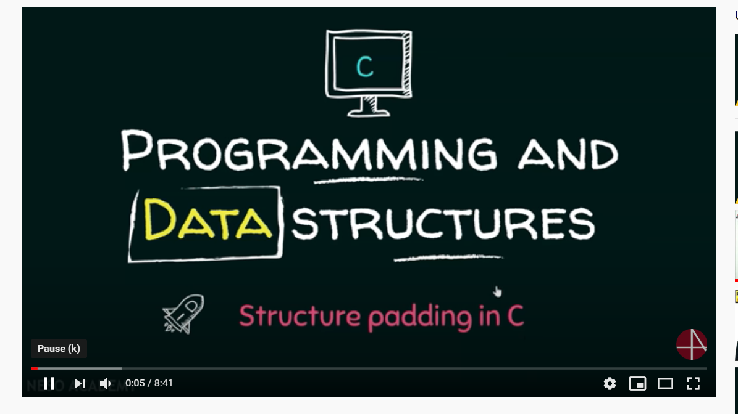
Discussion forum.
Watch this video to know more about how structures are stored in memory and what is meant by structure padding.
https://www.youtube.com/watch?v=aROgtACPjjg

Slide 35

REFERENCES
Reference Books
Programming in C by Reema Thareja.
Programming in ANSI C by E. Balaguruswamy, Tata McGraw Hill.
Programming with C (Schaum's Outline Series) by Byron Gottfried Jitender Chhabra, Tata McGraw Hill.
The C Programming Language by Brian W. Kernighan, Dennis Ritchie, Pearson education.
Websites:
https://www.geeksforgeeks.org/structures-c/
https://www.studytonight.com/c/structures-in-c.php
https://www.tutorialspoint.com/cprogramming/c_structures.htm
https://www.geeksforgeeks.org/union-c/
YouTube Links:
https://www.youtube.com/watch?v=Ranc3VvjI88
https://www.youtube.com/watch?v=zdUhS4YSWHg
https://www.youtube.com/watch?v=t7MD-Elr05k

Slide 36
THANK YOU

